Slide 1

Multi-layer Convolutions with LSTMs for forecasting

Slide 2
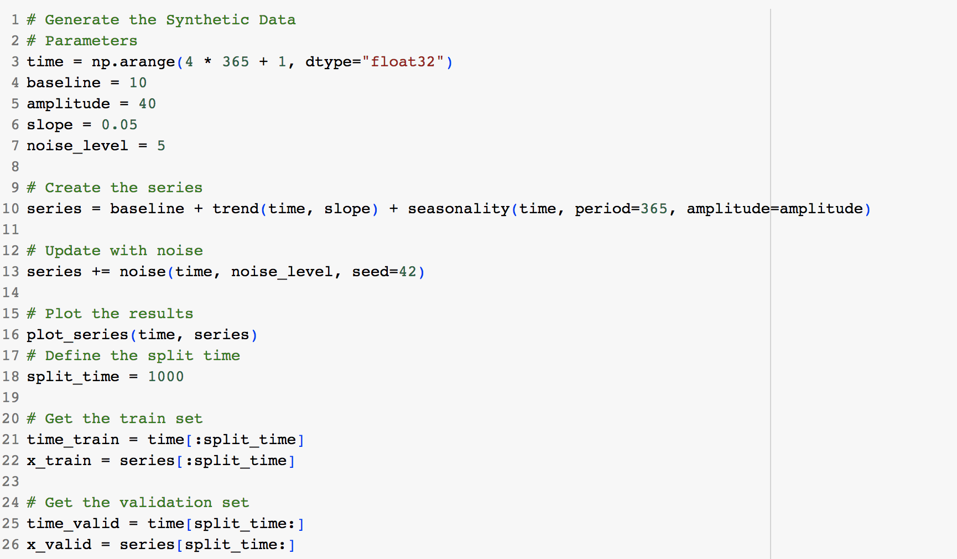
Objectives
Lab 4.2: Multi-layer Convolutions with LSTMs for forecasting.
Dataset:
  the Synthetic Data

Slide 3
Q & A

